Slide 1
Emerging Java Technologies
Jeremy Jones
Peyush Jain
John Jung
January 29th, 2004

Slide 2
Agenda
The Current State of Java
Java 1.5
  Generics
  Autoboxing
  Enhanced for loop
  Typesafe Enums
  Static Import
  Varargs
  Metadata
  Swing Changes
  XML
XUL and JDNC
Eclipse

Slide 3
The Current State of Java
Java is still going strong
  Great success on server / web apps
  Millions of Java VMs in cell phones
  Client-side Java less successful though
The “hype” phase is over
But big challenges remain
  Sun’s uncertain future
  Microsoft’s C# and .Net
  Microsoft’s Longhorn OS
  Open-sourcing Java still an issue for some

Slide 4
Java 1.5
(aka JDK 1.5, J2SE 1.5, “Tiger”)
Next major release of the Java platform
Significantly greater changes than in 1.4 or 1.3
  Few language changes in 1.4/1.3
First beta 1Q04, release end of 04?
Continued focus on performance and stability
  Despite this presentation’s focus on new features
Final set of features may change before release

Slide 5
Generics
When you get an element from a collection, you have to cast
  Casting is a pain
  Casting is unsafe - casts may fail at runtime
  Plus it’s not always obvious what type goes into or comes out of a collection
With Generics, tell the compiler what type the collection holds
  Compiler will add the casts for you
  Provides compile-time type safety
  Similar to C++ templates, but not the same

Slide 6
Example without Generics
// Removes 4-letter words from c; elements must be strings
static void expurgate(Collection c) {
for (Iterator i = c.iterator(); i.hasNext();) {
if (((String) i.next()).length() == 4) {
i.remove();
}
}
}
// Alternative form - a bit prettier?
static void expurgate(Collection c) {
for (Iterator i = c.iterator(); i.hasNext();) {
String s = (String) i.next();
if (s.length() == 4) {
i.remove();
}
}
}

Slide 7
Example with Generics
// Removes 4-letter words from c
static void expurgate(Collection<String> c) {
for (Iterator<String> i = c.iterator(); i.hasNext();) {
if (i.next().length() == 4) {
i.remove();
}
}
}
No cast, extra parentheses, or temporary variables
Provides compile-time type checking

Slide 8
Generics != Templates
Benefits of templates without all the baggage of the C++ version
  No code-size blowup
  No precompiler messiness
Simply provides compile-time type safety and eliminates the need for casts
BUT – Generics do not help performance
  Casts only hidden, not eliminated
  No direct support for primitive parameter types
    Uses autoboxing instead

Slide 9
Autoboxing/unboxing
Java has split type system
  Primitives (int, float, etc.) and Objects (String, etc.)
  Wrapper classes used to bridge the gap (Integer for int, Float for float, etc.)
Can’t add primitives to collections
  Collections take Objects
  Must wrap primitives in Objects first
Autoboxing does this wrapping/unwrapping for you
  Automatically wraps primitives in objects
  Automatically unwraps wrapper objects to primitives
Simplifies code
BUT – No performance advantages at all – only hides the wrapping
  Developer must still understand the costs involved
  Potentially lots of wrapper objects being created, which can be expensive

Slide 10
Enhanced for Loop
Iterating over collections is a pain
Often, iterator unused except to get elements
Iterators are error-prone
  Iterator variable occurs three times per loop
  Common cut-and-paste error
    Using the wrong iterator
Many languages have a “foreach” concept
  Now Java does, but without the “foreach” keyword
    Sun was very worried about backwards compatibility

Slide 11
Enhanced for Loop Example
// Without enhanced for loop
for (Iterator i = suits.iterator(); i.hasNext(); )
{
Suit suit = (Suit) i.next();
for (Iterator j = ranks.iterator(); j.hasNext(); )
{
sortedDeck.add(new Card(suit, j.next()));
}
}
// With enhanced for loop
for (Suit suit : suits)
{
for (Rank rank : ranks)
{
sortedDeck.add(new Card(suit, rank));
}
}

Slide 12
Typesafe Enums
Standard approach – int constants
  Not typesafe, no namespace, values are meaningless, etc.
Typesafe Enum design pattern helps
  Much better, but lots of code required
1.5 basically adds language support for the Typesafe Enum pattern
  Plus can be used in switch statements
More powerful than C/C++ enums
  Enums are classes, so can have methods, etc.

Slide 13
Typesafe Enums Example
// Simple example
enum Season { winter, spring, summer, fall }
// Enum with field, method, and constructor
public enum Coin {
penny(1), nickel(5), dime(10), quarter(25);
private final int fValue;
Coin(int value) { fValue = value; }
public int value() { return fValue; }
}

Slide 14
Static Import
Static members from a class must be qualified with the class name
  Math.cos(), Math.PI, etc.
Developers don’t like this, particularly for constants
  Some define “Constant Interface” which classes implement to get around this problem
    Generally recognized as a bad idea (“antipattern”)
Instead, import the static members from a class, rather than the classes from a package
  Can import static methods and fields
  Can import enums too!

Slide 15
Varargs
Sometimes you want a method that takes an arbitrary number of parameters
  Either use an array or overload the method signature
Java has no printf as a result
  printf basically requires variable arguments
C/C++ has it, but syntax is cumbersome
printf will be included too!

Slide 16
Varargs Syntax
public static String format(String pattern,
Object... arguments)
Parameter type of arguments is Object[]
Caller uses normal syntax

Slide 17
Metadata
Many APIs require “boilerplate” or “side” files associated with a specific class
  JAX-RPC web services
  EJBs
  JavaBean “BeanInfo” class
Creating and maintaining these associated files is painful
Instead, annotate the original class and let the tools generate the associated files for you
  Or do anything else – the use of this mechanism is undefined
  Simple example: @deprecated
This feature adds a generic mechanism for annotating classes/methods/fields
  The meaning of the annotations is not defined
  Different APIs (JAX-RPC, EJB, etc) will define their own “standard” annotation types
  Annotation types are declared like interfaces
    Provides compile-time checking
  Annotation types can contain parameters which must be specified

Slide 18
Metadata Example
// JAX-RPC web service interface and implementation
public interface CoffeeOrderIF extends java.rmi.Remote {
public Coffee [] getPriceList()
throws java.rmi.RemoteException;
public String orderCoffee(String name, int quantity)
throws java.rmi.RemoteException;
}
public class CoffeeOrderImpl implements CoffeeOrderIF {
public Coffee [] getPriceList() {
...
}
public String orderCoffee(String name, int quantity) {
...
}
}

Slide 19
Metadata Example
// JAX-RPC web service with metadata
public class CoffeeOrder {
@Remote public Coffee[] getPriceList() {
...
}
@Remote public String orderCoffee(String name, int quantity) {
...
}
}

Slide 20
Swing Changes
Not many Swing changes
Biggest change: New updated Java “Metal” Look and Feel
More work on the new Windows XP and GTK/Gnome Look and Feels
  Introduced in 1.4.2
Possible TreeTable component
More performance work

Slide 21
XML
1.5 adds core support for many new XML standards
  Namespaces
  Schemas
  XSLT
  DOM Level 3
Optional Web Services Developer Pack adds much more
  WSDL, SOAP, XML DSig, etc.

Slide 22
XUL and JDNC
Peyush Jain

Slide 23
XUL
XML User Interface Language
Pioneered by Mozilla
Makes cross-platform user interfaces as easy as building web pages
  No hard-coded, platform specific user interfaces (e.g. MFC, Qt, etc)
  Not another GUI API/toolkit/framework

Slide 24
Example
Swing XML Java Bean Persistence
<object class="javax.swing.JPanel">
<void method="add">
<object id="button1" class="javax.swing.JButton"/>
</void>
<void method="add">
<object class="javax.swing.JLabel">
<void method="setLabelFor">
<object idref="button1"/>
</void>
</object>
</void>
</object>

Slide 25
Example
Java Swing
JPanel panel1 = new JPanel();
JButton button1 = new JButton();
JLabel label1 = new JLabel();
panel1.add(button1);
panel1.add(label1);
label1.setLabelFor(button1);
XUL
<hbox>
<button id="button1" />
<label for="button1" />
</hbox>

Slide 26
XUL Architecture
User Interface (UI) divided into 4 parts
  Content
  Appearance
  Behavior
  Locale

Slide 27
XUL Motor - Luxor
Open-source XUL engine in Java
XUL toolkit includes web server, portal engine, template engine, scripting interpreter and more.
Tags
<box>, <hbox>, <vbox>, <action>, <border>, <button>, <checkbox>, <choice>, <entry>, <icon>, <label>, <list>, <map>, <menu>, <menubar>, <menuitem>, <menuseparator>, <panel>, <password>, <text>, <textarea>, <toolbar> and many more

Slide 28

Example
<list id="card">
<entry value="American Express" />
<entry value="Discover" />
<entry value="Master Card" />
<entry value="Visa" />
</list>
<vbox>
<label value="Choose a method of payment:" />
<choice list="card" />
</vbox>
<vbox>
<label value="Choose a method of payment:" />
<choice list="card" type="radio" />
</vbox>

Slide 29
XUL Benefits
Platform Portability
Splits presentation and application logic
Makes UI building easier
UI can be easily updated
UI can be loaded at start-up from web-server, database, etc
UI can be tested in browser like a web page

Slide 30
JDNC
Java Desktop Network Components
Used for creating Web-enabled Java desktop clients
  Very High Level Beans: Table, Tree, TreeTable, Editor, Form
  Built-in Data and Networking Smarts
  Leveraging XML for configuration
  Browser or Standalone Deployment

Slide 31
Example
Embedding the applet
<applet name="JDNCApplet" archive="table.jar, common.jar" code="com.sun.jdnc.JDNCApplet.class" width="800" height="300" align="middle">
<param name="config" value="bugtable.xml">
<param name="boxbgcolor" value="255,255,255">
</applet>
Configure the data model
Configure UI and bindings to the data

Slide 32
Example
Authoring the XML Configuration File
<jdnc-app>
<data id="bugdata">
<source url="bugs.txt"/>
<format mimetype="plain text">
<columns>
<column id="bugid">
<link>
</column>
<column id="priority">
<integer minimum="1" maximum="5"/>
</column>
<column id="state">
<string><values>
<value>dispatched</value>
<value>fixed</value>
<value>closed</value>
</values></string>
</column>
…

Slide 33
Example
<table id="bugtable" sortable="true" draggable="true" grid="true">
<statusbar/>
<rows margin="20"></rows>
<columns>
<column dataref="bugdata.bugid" label="BugID“ alignment="center">
<sample>8888888</sample>
</column>
<column dataref="bugdata.priority" label="Pri">
<sample>1</sample>
</column>
<column dataref="bugdata.state" label="State" editable="true" alignment="center">
<sample>dispatched</sample>
</column>
</columns>
</table>
</jdnc-app>

Slide 34
Eclipse
John Jung

Slide 35
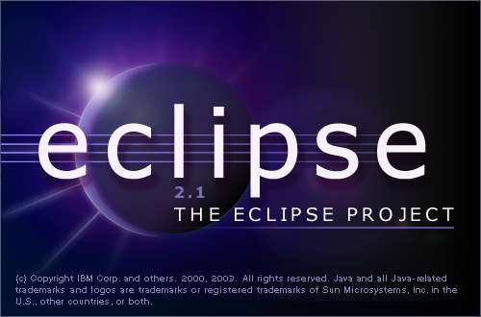
Eclipse - Overview
The Java IDE
The Application Platform
The Debate: SWT vs. Swing

Slide 36
Java IDE
Feature-rich IDE
  Java Perspective
    Standard Views: Navigator, Outline, Editor
    Other useful perspectives: Debug, CVS Repository
  Java Editor
    Code assist: hover – javadoc spec, ctrl-click to jump to source, method completion, dynamic syntax check, automatic error corrections
    Code generation: code templates, method insertion/generation, comment generation
    Refactoring: organize imports, renaming/moving
  Excellent help system
Best Feature: price

Slide 37
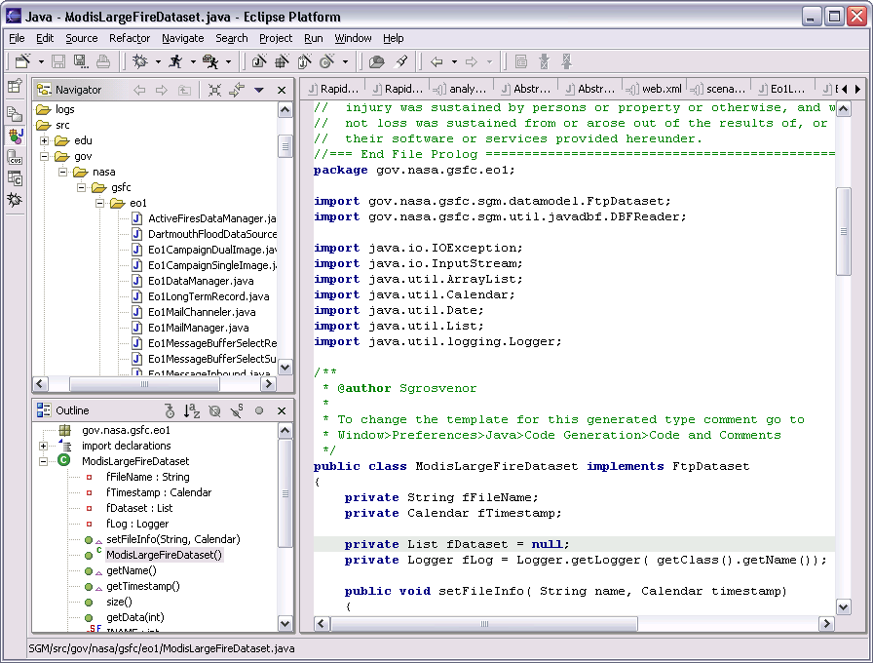
Java IDE

Slide 38
Application Platform
Eclipse is actually a thin layer that serves as the middleman between plug-ins and the OS; not just an IDE
Building applications using Eclipse become possible by developing plug-ins that interact with each other
Emerges as a competitor to Microsoft’s dominance on application building platforms (Visual Basic)
Gathering momentum: close to declaring independence from IBM; also close to the version 3.0 release

Slide 39
SWT vs Swing
SWT: Standard Widget Toolkit
  Small generic graphics/GUI set
    Buttons, lists, tables, text, menus, fonts, etc
  “Snappy”, faster, uses native widgets – better look and feel
  Memory de-allocation required, not object-oriented, must maintain different versions for different platforms
Swing
  Large, elegant set of tools
  Object-oriented, large libraries, easier to use, large user base, easy to maintain code, more flexible
  Can be slower, look and feel can be dated

Slide 40
SWT vs Swing
IBM – SWT – Eclipse
Sun – Swing – NetBeans
Two giants wage battle over which will be the main platform for Java applications
With Eclipse’s impending independence from IBM, Sun’s next move anticipated

Slide 41
References
Java 1.5
  http://java.sun.com/features/2003/05/bloch_qa.html
  http://servlet.java.sun.com/javaone/sf2003/conf/sessions/display-1540.en.jsp
  http://servlet.java.sun.com/javaone/sf2003/conf/sessions/display-3072.en.jsp
XUL and JDNC
  http://luxor-xul.sourceforge.net/index.html
  http://luxor-xul.sourceforge.net/talk/jug-oct-2001/slides.html
  http://luxor-xul.sourceforge.net/talk/vanx-jul-2002/slides.html
  http://www.javadesktop.org/articles/JDNC/index.html
Eclipse
  http://www.eclipse.org/
  http://www.eclipse.org/eclipse/presentation/eclipse-slides.ppt
  http://www.fawcette.com/javapro/2002_12/magazine/columns/proshop/
  http://news.com.com/2100-7344_3-5149102.html
  http://cld.blog-city.com/readblog.cfm?BID=15428

